Slide 1
pyGTK
Abhijit A.M.
abhijit.comp@coep.ac.in

Slide 2
GTK
GIMP Tool Kit (not GNOME Tool Kit)
Library for creating graphical user interfaces
LGPL license
  develop open software, free software, or even commercial non-free software
Originally written for developing the GNU Image Manipulation Program (GIMP) .. Let's see GIMP in action
  Now also used for GNU Network Object Model Environment (GNOME) .. Let's see it in action.
GTK is essentially an object oriented application programmers interface (API), written completely in C

Slide 3
pyGTK
PyGTK 2.0 is a set of Python modules which provide a Python interface to GTK+ 2.X
PyGTK website (www.pygtk.org)
PyGTK 2.0 Reference Manual is available at http://www.pygtk.org/docs/pygtk/

Slide 4
Before pyGTK, let's understand the concept of Modules
See mymodule.py and usemodule.py
A Module is also a namespace
  A class with same name can exist in two different modules
See the various comments in both files, and try out the uncommenting suggested in those files.

Slide 5
Our first pygtk program
See 1-gtk.py
This program simply shows a window
  We can't even close the window by clicking on close button
  Only Ctrl-C works in ending the program

Slide 6
2-gtk.py
This one adds a button to the window
Still, no mouse clicks work

Slide 7
3-gtk.py
Let's get introduced to the world of “event handlers”
Function hello is an event handler
We register the event handler hello(), for click action on the button, using the connect method of button
When actual click happens on the button, hello gets called
HW: Find out where the connect method is defined – whether in class Button or in some parent class.

Slide 8
4-gtk.py
Let's try to close the window properly
gtk.main_quit() makes gtk stop working
Who'll call this ?
  Some handler which gets called when we click on “close” button or press alt-f4

Slide 9
Where to study from ?
http://www.pygtk.org/pygtk2tutorial
  The pygtk tutorial
http://www.pygtk.org/docs/pygtk/
  Pygtk documentation
  All classes, their methods, etc.
Must read

Slide 10
Some terms
All graphical user interface programming kits, come with lot of “tools”, each with a name
Button, Window, Menu, Scroll bar, Menu item, Radio button, Toggle button, clipboard, label, toolbar, ...
Need to know the meaning of each
  The tutorial teaches us that also !

Slide 11
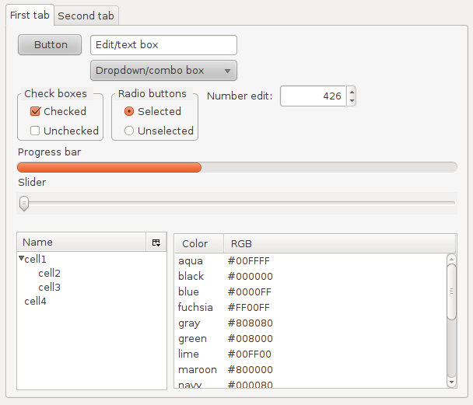
Widgets ...

Slide 12
The “X” relationship
X Window
  Basic windowing library
  Basic content of a window drawn by x
GTK
  Runs on top of X window
  Draws the title bar, clsoe, minimize, etc buttons, sends calls to X window system
KDE libraries
  Also run on top of X window

Slide 13
Let's learn more about the GTK Library
We'll go through examples given in the GTK Tutorial
Don't forget our aim:
  To write a xfig like application !
I'm uploading all the .py files from the tutorial as a single .tar.gz file to moodle.

